Slide 1
Team B Members
1.
2.
3.
4.
Questions
2. Identify Karolinska’s ‘customers’ and their specific quality needs? How is Karolinska addressing their needs?
8. Describe two examples of how you can apply the Karolinska experience to your Healthcare System?

Slide 2
Karolinska’s customers
Karolinska is a premier health facility based in Europe. It collaborated with Karolinska Institutet to offer development and medical break-through towards its customers who are segmented as;
Children – the hospital offers specialized paediatric care to children with epilepsy, burns, neonatal care, liver and kidney diseases, ECMO needs, among others. Cochlear implant needs are also done.
Dermatology patients – the hospital specializes with all areas of dermatology. Skin lymphoma, Laser treatment of Naevus flammaeus, Mohs surgery are some needs for this segment.
Adults and chidren in need of neurosurgery.
Patients who need plastic surgery.
Patients who need stem cell transplantation.

Slide 3
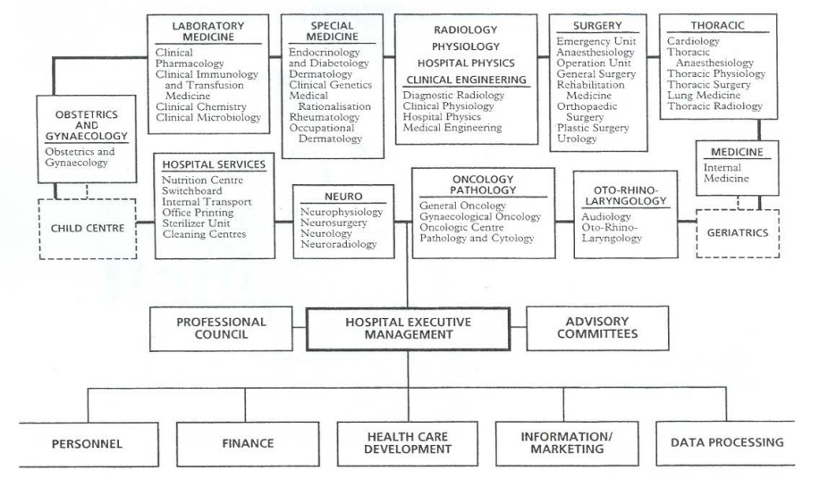
Staff and management

Slide 4
How the needs are addressed
Essentially, quality and cost have been traded off to assemble a myriad of services in the facility.
The new Karolinska Solna has been expanded into a state-of-the-art that it specializes in.
The use of EIZO monitors has had been one of the most simplest and effective way of carrying out activities in the company. EIZO monitors ensure quality at an economical price.
As the head of MT X-ray unit reports, the monitors need very low maintenance. The engineer need to recheck them twice in an year.
RadiCS and RadiNET Pro provides an excellent overview of the status on all 450 diagnostic monitors that are connected to RadiNET Pro.
The hospital has invested in the use of advanced information systems, that has improved the functionality of the hospital.

Slide 5
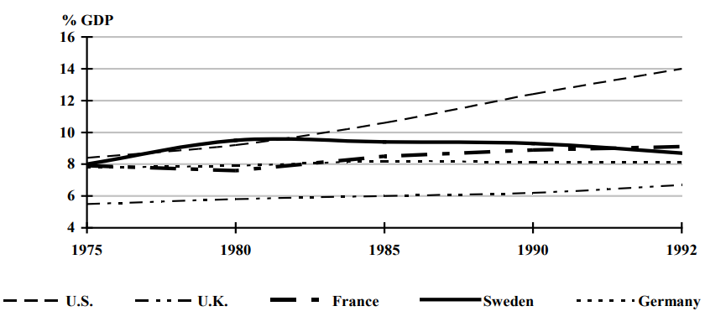
Expenditures; see the reduction over the years

Slide 6

Describe two examples of how you can apply the Karolinska experience to your Healthcare System?
The healthcare crisis is being experienced in nearly all the countries of the globe.
The struggle is always on how to balance the fluctuating costs of treatment with the rising demand. The health expenditure is, today a major portion of GDP. This means that the crisis is felt by everyone.
To apply Karolinska’s experience in an individual healthcare;
Integrating the use of advanced information systems in the facility is the priority intervention. Communication strategy is very prime in any organization regardless of the business conduit. Ideally through a definite communication system, the facility will transform its business by turning to the pressing matters as a priority.

Slide 7
Cont.’
B. Introducing market principles, i.e. the customer and provider split. Like Karolinska has defined its service packages and how its has split its services into departments like the children’s, the same way an individual health facility will need to define its market and the services it offers.
Also, the use of generic drugs and purchasing in bulk and lowering of care level is a good way f trading off quality and cost.
In any way possible, increase resource commitment through ways that work for your patients. Taxation is somehow unpopular, just like Karolinska, don’t use it.
Install technology that will work your services effectively.

